Slide 1

CROP RECOMMENDATION SYSTEM

Slide 2
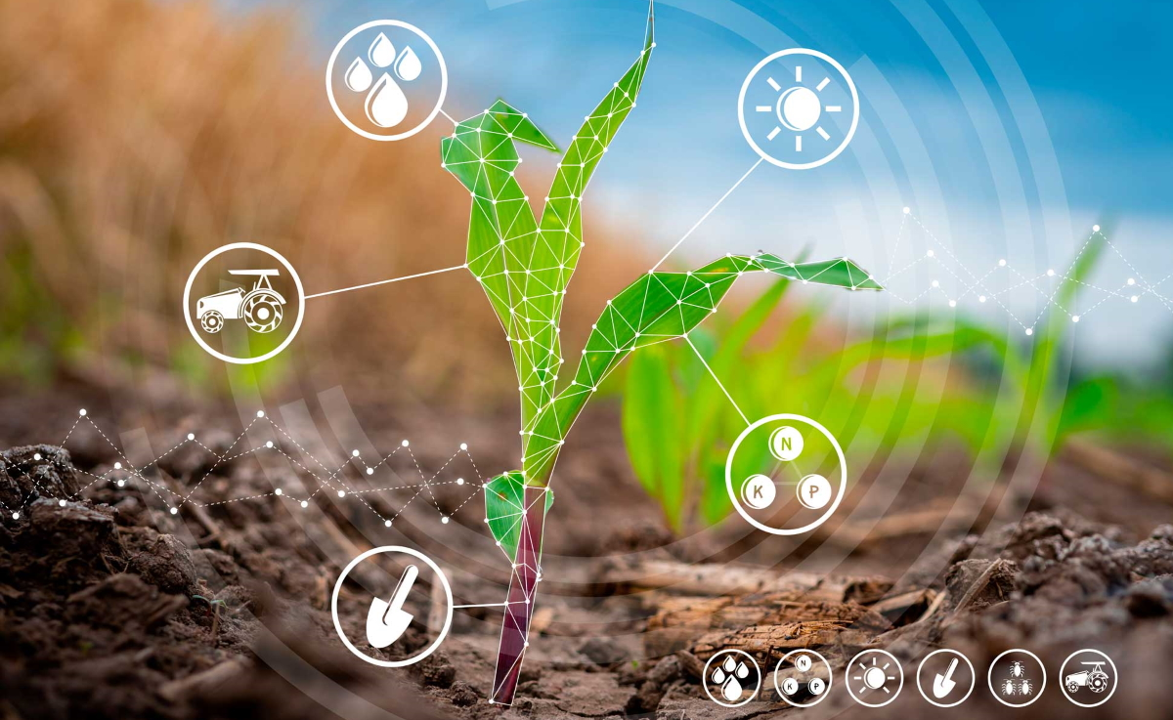
GROUP MEMBERS:
B. LAKSHMIKANTH REDDY – CB.EN.U4CCE20011
D. ABHIRAM – CB.EN.U4CCE20021
K. SAI HRITHIK – CB.EN.U4CCE20027
N. CHARAN REDDY – CB.EN.U4CCE20035

Slide 3
INTRODUCTION
The situation of farmers is not good in India. Despite employing half the population in agriculture, the agriculture sector contributes to only 20% of Indian GDP.
Hence, it is in dire need of improvement to make a good and profitable yield and a practical need without harming the nature. That’s where technology comes in and can have major effects on agricultural sector.
Basically, this project aims to tackle the difficulties faced by the farmers and aims to provide a correct crop for the farmers to grow and avoid the undesirable results by providing effective solutions using machine learning techniques.

Slide 4
OBJECTIVE
Agriculture practices in the country are largely primitive and technological change in the sector is slow. Effective technology can be used to increase the yield and to reduce the maximum possible challenges in this field.
Most of the times it is observed that farmers tend to sow the crop according to its market value and possible financial profits rather than taking factors like soil conditions, sustainability etc. into the account. This may lead to undesirable results for farmers and for the nature of soil too.
In today’s time, technologies like machine learning and deep learning can become game changers in such fields if they are used in a proper manner

Slide 5

IMPLEMENTATION
IMPORTING LIBRARIES
IMPORTING DATASET
COLUMN DESCRIPTION
EXPLORATORY ANALYSIS
PAIR PLOTS AND HEAT MAP
DATA PREPROCESSING
APPLYING MACHINE LEARNING MODELS
COMPARSION
PREDICTION

Slide 6
APPLYING MACHINE LEARNING MODELS
LOGISTIC REGRESSION
DECISION TREE
K- NEAREST NEIGHBOR (KNN)
NAIVE BAYES
RANDOM FOREST
SUPPORT VECTOR MACHINE (SVM)

Slide 7
RESULTS

Slide 8
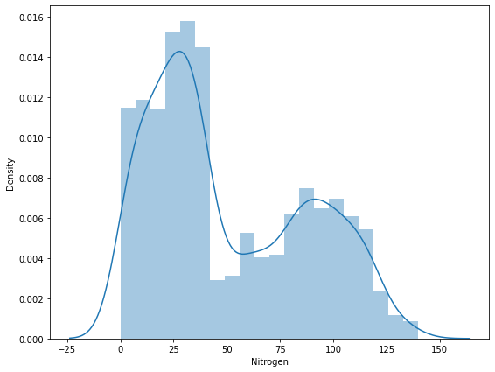
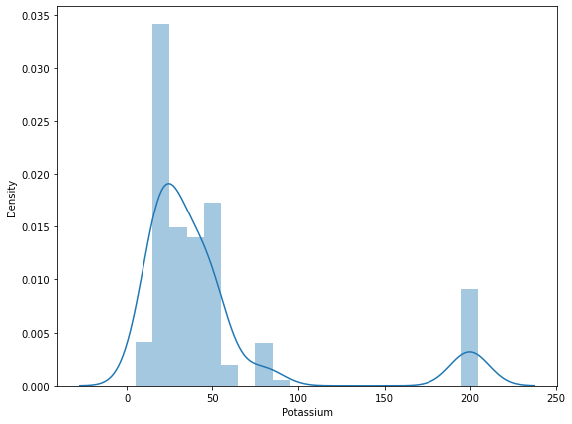
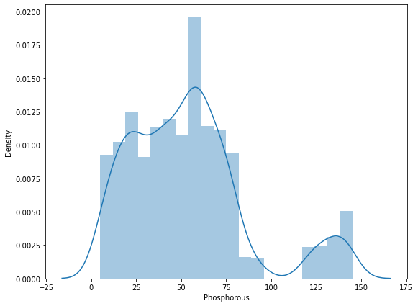
Elements Vs Density

Slide 9
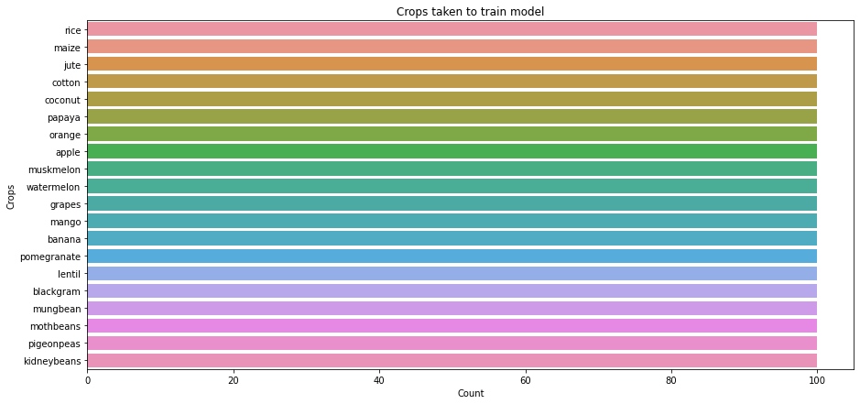

Slide 10
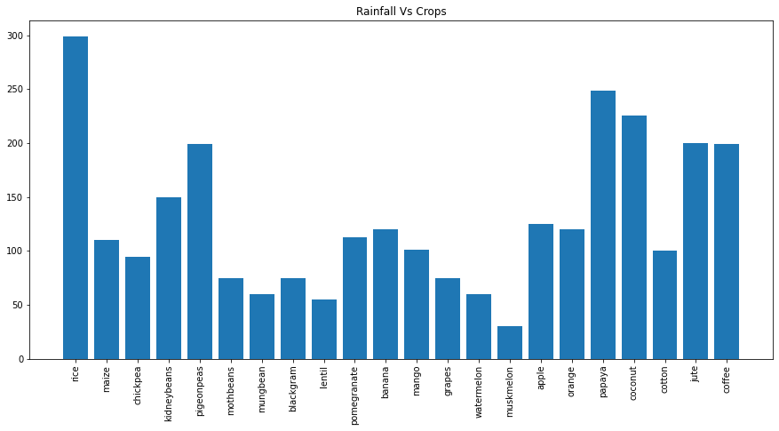

Slide 11
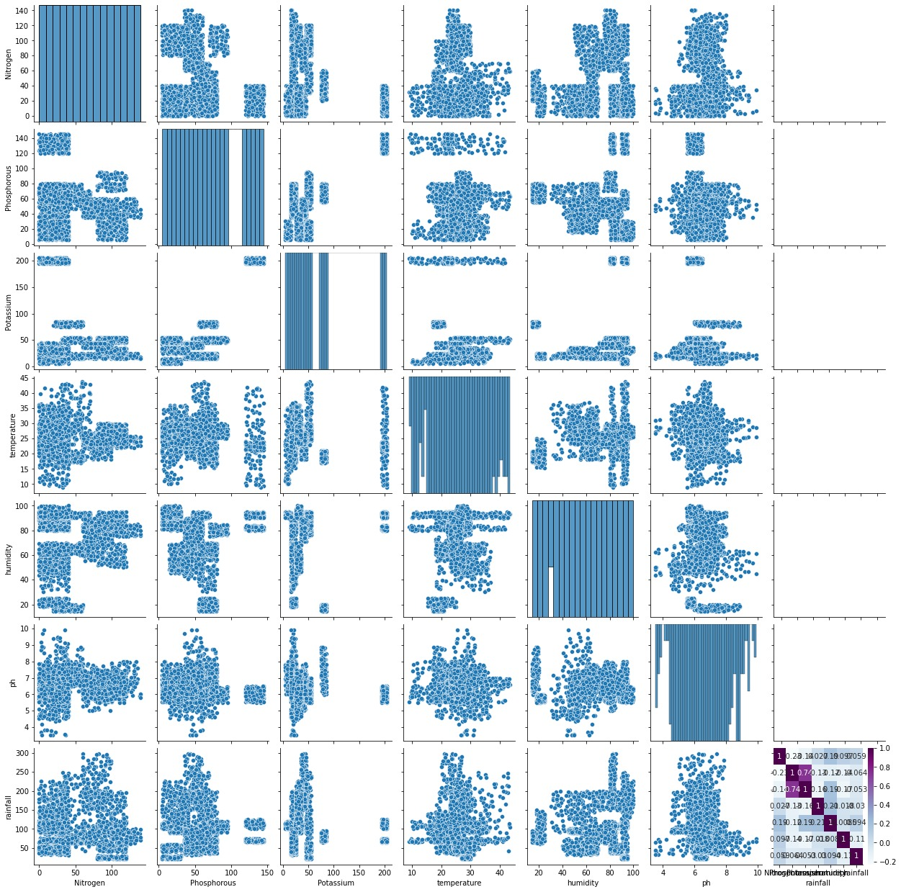
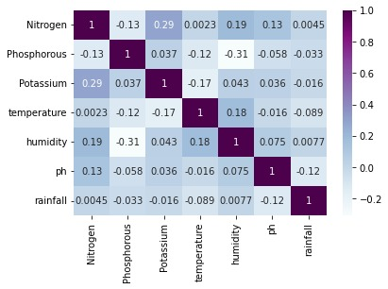

Slide 12
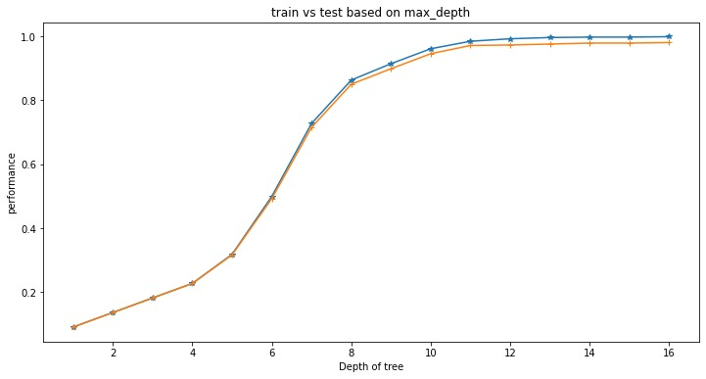
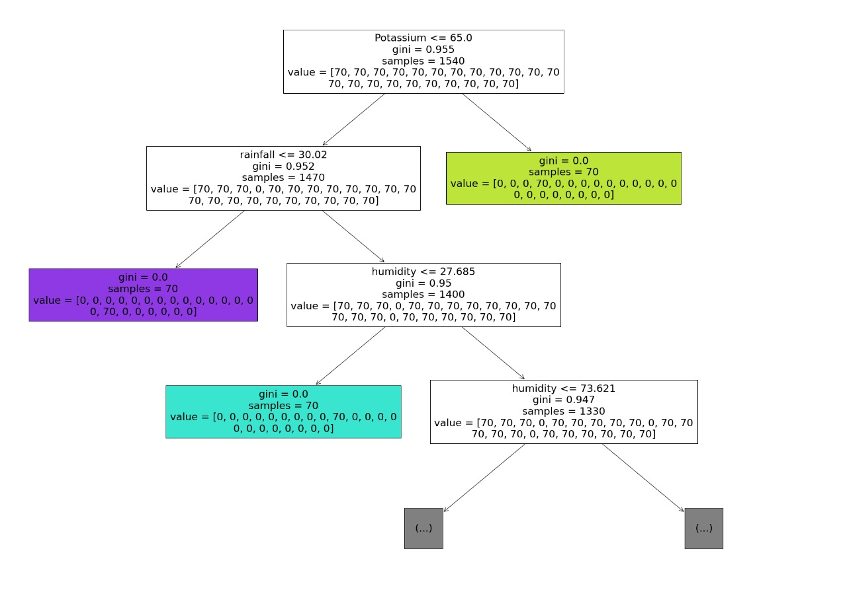

Slide 13
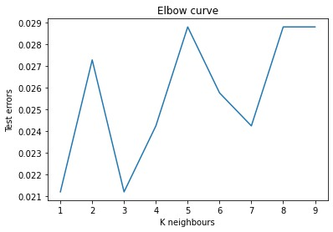

Slide 14
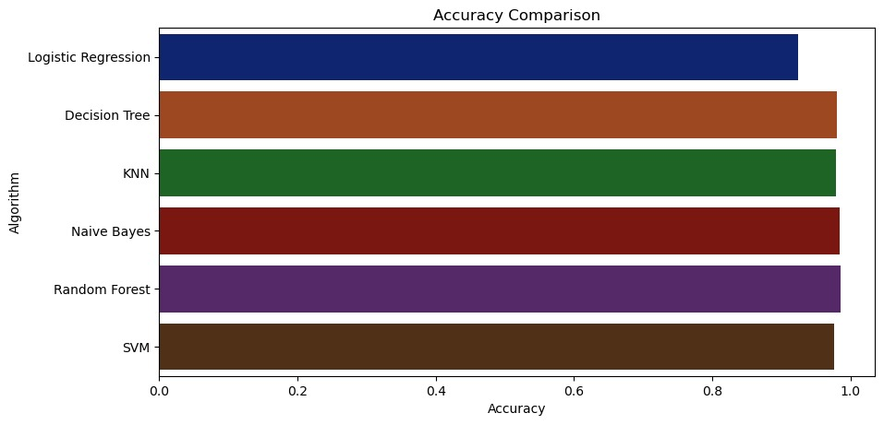

Slide 15
FUTUTRE SCOPE
At present this project limited the scope only to a crop recommendation system, but this in the future can be extended to other areas such as fertilizer recommendations, where in a person can get the information of the fertilizer suitable for his crop. Another extended application of this could be plant disease classification using CNN and giving a remedy to that disease. As agriculture is quite an unexplored area, the scope for such a type of project is tremendous.

Slide 16
REFERENCES
WB-CPI: Weather Based Crop Prediction in India Using Big Data Analytics IEE Journal- https://ieeexplore.ieee.org/document/9557312
Intelligent Crop Recommendation System using Machine Learning- https://ieeexplore.ieee.org/document/9418375
Crop Recommendation System Using Machine Learning Algorithms- https://www.irjet.net/archives/V9/i4/IRJET-V9I4214
Data Mining - Concepts and Techniques, Jiawei Han and Micheline Kamber, Second Edition, 2006

